Slide 1


Debugging Transient Faults in Data Center Networks using “Synchronized Network-wide Packet Histories”
Pravein Govindan Kannan Nishant Budhdev Raj Joshi Mun Choon Chan
Notes:
Hello everyone, I am Pravein from IBM Research India
Today I will be presenting our work on debugging transient faults in data center networks using synchronized network-wide packet histories.
This work was done along with Nishant, Raj and prof Mun Choon Chan in National University of Singapore.

Slide 2








Cloud Reliability is Critical
Cloud Downtime is Expensive
$300K/ Hour - Gartner report
Notes:
Cloud reliability is critical, with several businesses and services relying on them. Especially, video conferencing in these days.
These cloud services are supported by data centers at the scale of several thousands of devices with complex inter-connects.
Failures are extremely sensitive, which can result in hurting the customers' revenues and incur huge loss for the cloud providers.

Slide 3
Data Center Network Failures
Root-cause could not be determined :
Transient
Inability to correlate events
Notes:
Data center operators have noted that most of the data-center outages are caused by network failures.
And among the network failures, relatively large proportion(29%) of the failures go without establishing the root-cause.
It was observed that the failures that could not be root-caused were transient in nature and the debugging information which is collected at different places and could not give a complete picture to correlate events.

Slide 4

Transient Faults : Microbursts
“µbursts : periods of high utilization lasting less than 1 ms, exist in production data centers.”
“ They encompass most congestion events.”
“The p90 burst duration is ≤200 µs.”
[IMC’17]
Notes:
One example of transient network faults are Microbursts, which are periods of high utilization lasting few microseconds. It has been found that such issues in fact encompass most congestion events in the network.

Slide 5



Transient Faults : Microbursts
Reasons Could be:
Synchronized Application Traffic
Network Queueing
Heavy Hitter
Network Misconfiguration
S5
S10
S3
S4
S8
S9
High Queueing
due to Burst
S1
S2
S6
S7
H1
H2
H3
H4
H5
H6
H7
H8
Notes:
Reasons of microbursts could be due to synchronized incast traffic when multiple hosts send traffic to a single host as shown in this example. However, it could also be because of network queueing due to load imbalance, or heavy hitters or network misconfiguration and so on.

Slide 6


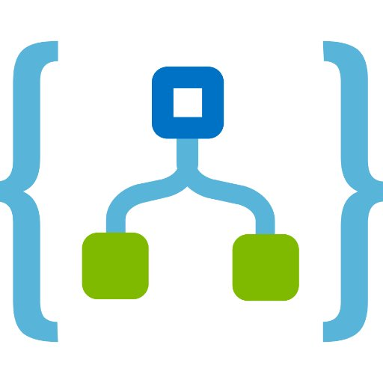
What do we need from the network?
Visibility
Retrospection
Correlation
Notes:
So,To Establish the right root-cause of a fault, The main question is what capabilities do we need from the network?
1) Visibility : Network-wide and fine-grained visibility into each part of the network
2) Retrospection , that is we knew the sequence of events that happened before the fault occurred to be able to find the root cause for the fault
3) Correlation : Ability to correlate the different events happening in different parts of the network.
Now, lets look at “Visibility & Retrospection”

Slide 7
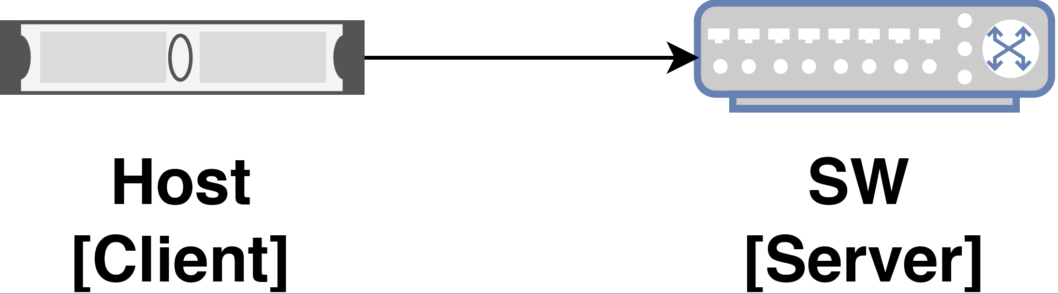

Visibility
Retrospection
Programmable Networks
Per-packet Postcards
[NetSight*, INT-XD]
Controller
Creates a post-card per packet
﻿* ” I Know What Your Packet Did Last Hop: Using Packet Histories to Troubleshoot Networks “, N. Handigol, B. Heller, V. Jeyakumar, D. Mazières, and N. McKeown, NSDI, 2014.
Notes:
To address the issue to visibility and retrospection, Recently, with programmable switches, There have been approaches such as per-packet postcards or INT-XD in programmable networks, where for each data packet, a control packet containing the packet’s header information is created by the switches and sent to a central controller. This way you have all the information before a fault occurs.

Slide 8
Visibility
Retrospection
Per-packet Postcards
[NetSight*, INT-XD]
Not scalable, due to throughput and storage overheads.
Creates a post-card per packet.
﻿* ” I Know What Your Packet Did Last Hop: Using Packet Histories to Troubleshoot Networks “, N. Handigol, B. Heller, V. Jeyakumar, D. Mazières, and N. McKeown, NSDI, 2014.
Notes:
The main problem with this approach is that there is a bottleneck due to limited network bandwidth available for exporting the postcards and storage overheads which cannot scale to several tera-bits per sec.

Slide 9
Visibility
Retrospection
In-band Network Telemetry
[INT]
Reduces goodput by upto 20% [PINT, SIGCOMM ‘20]
Attaches telemetry information in the packet
Notes:
A diametrically opposite approach would be to append telemetry information in the packet headers in data-plane [10,60,61] as done by INT
This approach uses selective hosts to store the appropriate per-packet telemetry information after extracting the headers.
The main problem with this approach is that due to telemetry information embedded in the packets, it reduces the goodput of the network by upto 20%.

Slide 10
Visibility
Retrospection
In-band Network Telemetry
[INT]
Network Faults occur infrequently [Facebook, IMC’ 18]
Problem Detected!
Reactive Approaches lose History
Notes:
Nevertheless, collection of telemetry continuously in an operational network may be wasteful, as network faults occur very infrequently i.e. few faults every hour.
Hence, it's possible to collect telemetry information after a fault has been detected.
However, such a reactive approach would miss out on the retrospection aspect i.e the historical information required for finding the root cause, especially in the case of hard-to-reproduce transient faults.

Slide 11
How do we solve? : An Outline
Visibility
Retrospection
Correlation
Compressed
Packet Records in
switch memory
Data-Plane
Time Synchronization
DPTP[SOSR ‘19]
DTP[SIGCOMM ‘16]
Export record recent history of packet records
+
Fault detection in the data-plane
SyNDB
Notes:
So, How do we solve this problem of getting visibility and retrospection from the network?
Leveraging Programmable switches,
We record the packets as compressed packet records with telemetry inside the switch memory itself
Next, since we cannot afford to flush the recorded data all the time due the overheads involved as previously mentioned, we design a fault-detection system in the network data-plane to selectively export the recorded history to controller for debugging.
Finally, we need to correlate the collected precords at high resolution. For this purpose,, we leverage recent data-plane time synchronization protocols , which provides nanosecond-level time synchronization between the data-plane clocks of the switches in the network . Hence, global time is available in the switch-dataplane while maintaining the precords.
With these three complementening techniques covering visibility, retrospection and corelation, we develop Synchronized network debugger (SyNDB)

Slide 12
Packet Records
Compression : Packet Records
(precords)
S5
S10
Ingress Port
Hash | Time_{In} | Time_{Queue} | Stat
Ring Buffer
in switches
S9
Time-Synchronization
using DPTP
S3
S4
S8
S1
S2
S6
S7
H1
H2
H3
H4
H5
H6
H7
H8
Notes:
Now, let me go into the details of of our solution,
In Syndb, the switch data-plane clocks are synchronized using a recent data-plane timesynchronization protocol (called dptp)
Each switch maintains a recording ring buffer which compresses and stores packets record (we call it precord) upon reception of a packet. A precord typically contains a hash of the packet header, time it entered the switch, and amount of time it queued. Additionally, it can contain custom statistics that can be configured by the operator, lets say ingress port from which the packet came.
The key idea is to leverage the switch data-plane as a fast temporal storage to do continuous recording of records as a moving time window.
When no network fault is detected, the recording window moves ahead and the older packet records beyond the record time-length is discarded.
Hence, this ring buffer always maintain the recent history of events/packets.

Slide 13
In-Network Fault Detection
S5
S10
Programmable
Fault Triggers
e.g.
Queueing delay > Threshold
S3
S4
S8
S9
High Queueing
due to Burst
S1
S2
S6
S7
H1
H2
H3
H4
H5
H6
H7
H8
Synchronized Fan-In Traffic
Notes:
Next, the history of precords is needed when a network fault occurs.
To do this, SyNDB allows operators to program custom fault trigger conditions.
For example, the operator could configure the trigger to be high queueing delay for packets which means congestion.
Now during network operation, lets consider a synchronized fan-in traffic from many hosts to single hosts, causing incast thus, leading to high queueing delays at switch S7

Slide 14

Packet record Collection
Collector
(Debugger)
S5
S10
1) Notify the entire
Network
2) Send Records
to collector
S3
S4
S8
S9
High Queueing
due to Burst
S1
S2
S6
S7
H1
H2
H3
H4
H5
H6
H7
H8
Notes:
Upon Trigger hit at S7, it notifies all other switches, and all switches in the network freeze their ring buffer.
Now, collection happens individually in each switch and all the precords are evicted and sent to the collector via control-plane channel without affecting the data-plane traffic.
Since, timestamp is attached to every precord, collection can be performed out-of-order and collector can easily re-order them

Slide 15

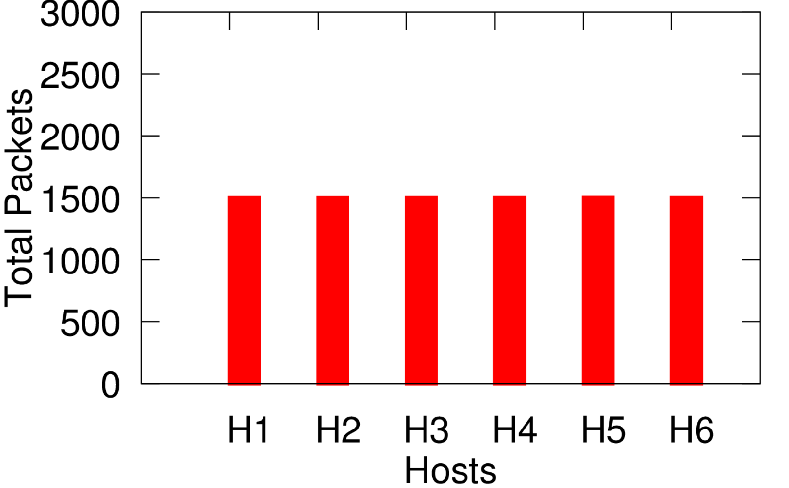

Query-based Debugging
Collector
(Debugger)
Packets Seen at S7
S5
S10
S3
S4
S8
S9
High Queueing
due to Burst
S1
S2
S6
S7
H1
H2
H3
H4
H5
H6
H7
H8
Notes:
The precords are received by the collector, which then processes and orders them and eventually stores them in a relational database (RDBMS) which allows operators to perform network-wide queries.
Now, after the microburst, If the operator looks at packet distribution at S7, there is just equal distribution of packets from different hosts.
Hence, just local information is not sufficient to debug the root-cause of this microburst.

Slide 16
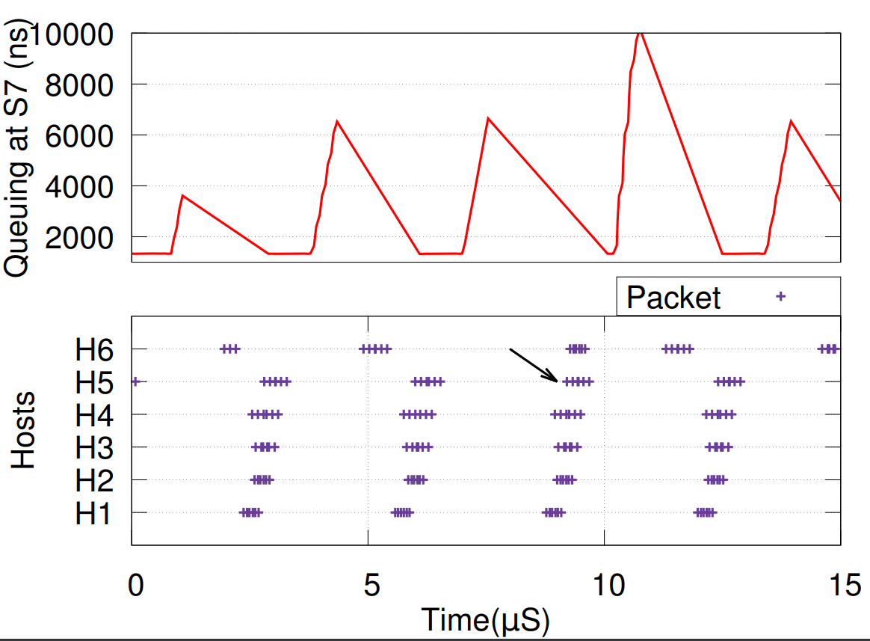
SyNDB : Query-based Debugging
SELECT switch, time_in
FROM packetrecords WHERE hash
IN (SELECT hash FROM packetrecords AS A
JOIN triggers as T ON (A.time_in < T.time AND A.switch = T.switch))
AND switch IN (SELECT switch FROM switches WHERE type = "tor");
SELECT time_queue FROM packetrecords where switch=7;
Collector
(Debugger)
S5
S10
S3
S4
S8
S9
High Queueing
due to Burst
S1
S2
S6
S7
H1
H2
H3
H4
H5
H6
H7
H8
Synchronized Fan-In Traffic
Synchronized Fan-In Traffic
Notes:
However, with syndb, since we have the abilitiy to retrospect network-wide packets records,
To determine if the issue of microburst is caused by synchronized fan-in traffic, a query of the queuing delay at S7 together with the packet arrival information at the ToR switches before the microburst detection can be performed.
The top plot in the figure illustrates the queue buildup over time, and the bottom plot shows the packet-arrival timings of the hosts at the respective ToR switches.
When we correlate the packet arrivals from different hosts before the bursts occurred, we see that the packets that make up the bursts are transmitted by hosts H1 to H6 at about the same time in a synchronized fashion.
This way, the root cause of incast from H1 to H6 can be determined and appropriate measures can be taken.

Slide 17
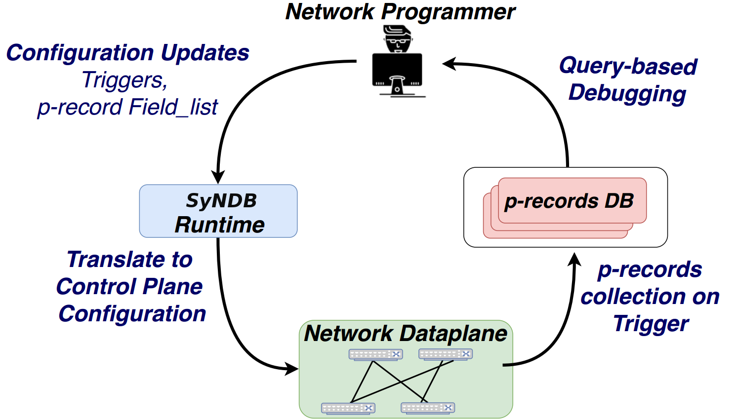
SyNDB Runtime
precord {
fields {
field_list_1;
field_list_2;
...
}
default_field : field_list_{x};
history : {y};
future : {z};
time_window : {t ms};
}
trigger {
conditions {
c1 = condition_1;
c2 = condition_2;
...
}
collection {
c1 [&|] c2’ [&]] c3’ ..
}
Notes:
Now, during regular network operation, syndb runtime provides the network programmer an interface to configure the statistics to be recorded in precords, and to customize the fault triggers
This configuration is initially used to generate P4 program to be programmed in the network data-plane.
The configuration can be changed at run-time without re-compiling the network program. Please refer to the paper for more details on the runtime.

Slide 18
SyNDB Implementation & Evaluation
Mini-testbed (Fat-Tree 2)
Barefoot Tofino Switch (Wedge100BF-32X)
1900 lines of P4 code
1000 lines of Control Plane code in C
SyNDB Runtime
~4000 lines of RUST code for compiler and Translation to P4
Simulation (Fat-Tree 24)
SyNDB Simulator
Packet-level simulator
~6000 lines of C++
Consistent precord captures
Debugging Microbursts, Network misconfiguration, etc
Notes:
Now, let me go into the implementation and evaluation of SyndB.
We have implemented syndb on a mini-testbed using Barefoot Tofino [20] switches over P4 (∼1900 LoC) and the syndb runtime using RUST
Using the mini-testbed, we evaluate the consistency of capure of precords in the data-plane and debugging of certain faults like microbursts and network misconfiguration.
Additionally, we also implement a packet-level simulator to understand the retrospection and correlation capabilities of syndb on a bigger network.

Slide 19
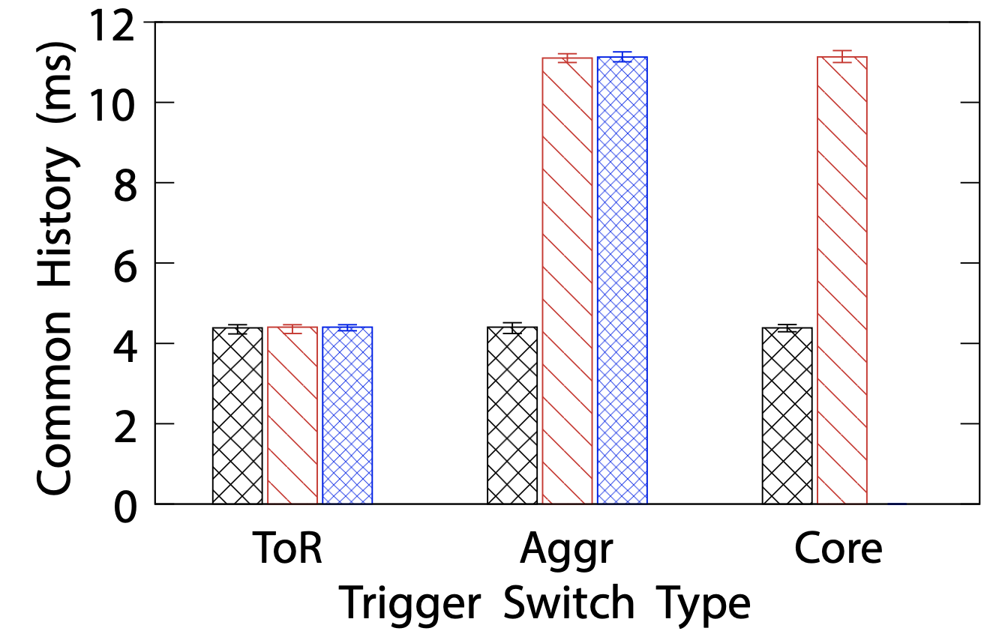
Retrospection & Correlation (Simulation)
Fat-Tree 24 (720 Switches, 3456 Hosts) with 100G Links (172.8 Tbps)
Traffic Model scaled based on real-world DC* (web apps)
4 ms – 11 ms History
* “Network Traffic Characteristics of Data Centers in the Wild”, T. Benson, A. Akella, and D. A. Maltz, IMC 2010
Notes:
Based on simulation, We study how much of end-to-end packet history is recorded by syndb in a large DC network, with realistic workloads based on datacenter measurements.
we observe that syndb could capture 4ms to 11ms of history from across the ends of the network for a network fault depending on whether the trigger occurs in the destionation ToR, or the core of the network.
This is equivalent to 100’s of RTT of history for packet-level debugging of a fault.

Slide 20
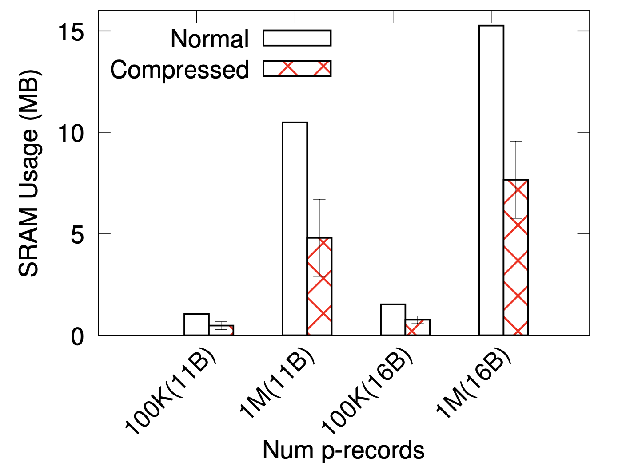
SRAM Overhead
5 – 7 MB SRAM
Notes:
And to get this amount of history, we observe that Syndb utilizes 5-7MB of sram on average per switch to maintain the precords. With recent switches supported several from several 10’s of mb upto few 100MB of SRAM,
Syndb can be implemented on current switches to support this amount of history for debugginguiy89u56rtdfiokx.

Slide 21

SyNDB Synchronized Network Debugger
A first of its kind network-wide Synchronized Debugging framework for network-wide debugging.
SyNDB can be implemented in existing switches and support several ms (100’s of RTTs) of packet histories.
SyNDB exports packet histories only on detecting faults, thus saves storage and network overhead by a magnitude at line-rate.
https://github.com/rajkiranjoshi/syndb-sim
Notes:
To Conclude, we design and implement syndb, which to the best of our knowledge, is the first packet-level synchronized monitoring framework for the entire network.
Syndb can be implemented in existing switches and support 10’s of RTT for debugging.
Since Syndb exports packet histories only upon faults, it saves a magnitude of storage network overhead at line-rate.
Thank you for listening to my talk, our simulator code is available in the given link, and pls refer to the paper for further details and other interesting use cases of syndb.

Slide 22
Backup

Slide 23
How do we solve?
Visibility
Retrospection
Correlation
Compressed
Packet Records in
switch memory
Export record recent history of packet records
+
Fault detection in the data-plane
Notes:
So, How do we solve this problem of getting visibility and retrospection from the network?
Leveraging Programmable switches,
We record the packets as compressed packet records with telemetry inside the switch memory itself
Next, since we cannot afford to flush the recorded data all the time due the overheads involved as previously mentioned, we design a fault-detection system in the network data-plane to selectively export the recorded history to controller for debugging.
This way, we get both visibility and retrospection for a particular fault.
Next, we will look at correlation

Slide 24
Q. Can we use global time to correlate events between switches?
Correlation
Correlate Events in the network using Global Timing
DTP : Datacenter Time Protocol [SIGCOMM ‘16]
DPTP : Data-Plane Time-synchronization Protocol [SOSR ‘19]
Switch-to-Switch synchronization Error (Bursty network):
1-2 Hops : Up to 10 ns
3-4 Hops : 99th percentile : ~47 ns
Notes:
To correlate network events at nanosecond-scale, we need the right ordering of the packets/events in the network. To do this, we need precise time-synchronization in the network data-plane.
Recently, there have been synchronization protocols proposed for the network data-plane, which provide nanosecond-level synchronization between two switches.
The question is can we use global time at the data-plane to correlate events between two switches:

Slide 25
Time Synchronization : Consistency?
Time
C_{X}
_{X}
Packet A
Prop Delay
C_{Y}
_{Y}
Packet A
Notes:
This question arises because there are errors in clock synchronization, the question is whether events will be recorded consistently.
Let's consider two directly connected switches X and Y, with internal clocks $C_X$ and $C_Y$ respectively.
To ensure causal consistency in the recorded packet events, we should see packet A leave switch X before reaching switch Y.

Slide 26
Time Synchronization : Consistency?
Time
When does inconsistency occur?
C_{Y}
_{Y}
Prop Delay
C_{X} = C_{Y} + T_{err}
Packet A
_{X}
Hence, Packet-level Consistency can be achieved with DPTP
T_{err} > Prop Delay
DTP, DPTP: 10’s of ns
< 360 ns to 1900 ns
Based on previous measurements (DPTP)
(Egress Delay + Mac & DeparserDelay + Wire Delay)
Notes:
Assuming Terr is the synchronization error, An inconsistency is when the packet’s reception at switch Y is recorded while its transmission from switch X is not recorded.
For this to happen, Terr should be greater than propagation delay (between the switches).
DPTP has shown that T_{err} between neighboring switches is in the order of tens of ns.
And prior measurements have shown that propagation delay between two adjacent switches ranges between 360\,ns to 1900\,ns under varying traffic conditions.
Thus it is possible to achieve packet level consistency between events recorded in adjacent switches, with current data-plane time synchronization techniques

